Slide 1

Project Title:
A Spark – Based Big Data Analytics Framework For Competitive Intelligence
217Q1A6728 - M . Srinivas
217Q1A6730 - M . Rohith Kumar Chary
217Q1A6722 - J . Nagaraju
217Q1A6741 - Sakshi Amit Goswami
Guide :
Mr. T. Ravinder Reddy
HOD :
Mr. T. Ravinder Reddy

Slide 2
Content
Aim of the project
Abstract
Introduction
Existing System
Proposed System
Modules
System Requirements
Feasibility Study
Algorithm
UML Diagrams
Screen-shorts
System Testing
Conclusion

Slide 3
Aim of the project
The aim of the project “A Spark-Based Big Data Analytics Framework for Competitive Intelligence” is to develop a scalable and efficient big data analytics system using Apache Spark to extract, process, and analyze large volumes of structured and unstructured data. This framework is designed to support competitive intelligence by enabling real-time analytics, predictive modeling, and visualization to help organizations gain strategic insights into market dynamics, competitor behavior, and emerging trends. Ultimately, the project seeks to empower decision-makers with data-driven insights to enhance their strategic planning and maintain a competitive advantage.

Slide 4
Abstract
The project on "A Spark-Based Big Data Analytics Framework for Competitive Intelligence" introduces an innovative solution for harnessing the power of big data analytics to gain strategic insights into competitive landscapes. Leveraging Apache Spark as the core engine, the framework facilitates the processing and analysis of large-scale datasets, enabling organizations to make informed decisions in dynamic business environments.

Slide 5
Introduction
In today's fast-paced business landscape, competitive intelligence plays a pivotal role in driving organizational success. This project focuses on the development of a robust big data analytics framework powered by Apache Spark, aiming to provide businesses with the tools and capabilities needed to extract meaningful insights from vast and diverse datasets for strategic decision-making.
Key Features:
Apache Spark Integration: The framework leverages the distributed computing capabilities of Apache Spark to efficiently process and analyze large volumes of structured and unstructured data.This ensures scalability and high-performance analytics for competitive intelligence tasks.

Slide 6
Real-time Data Processing: The framework enables real-time data processing, allowing organizations to stay abreast of dynamic changes in the competitive landscape. Real-time analytics empower decision-makers to respond promptly to market shifts and emerging trends.
Competitive Landscape Mapping: Through sophisticated algorithms and machine learning techniques, the framework provides tools for mapping the competitive landscape. This includes identifying key players, assessing market share dynamics, and uncovering patterns that influence competitive positioning.
Predictive Analytics: Employing advanced predictive analytics models, the framework aids in forecasting market trends and competitor behaviors. This forward-looking approach enables organizations to proactively adapt strategies and capitalize on emerging opportunities.
Scalable Architecture: The architecture of the framework is designed for scalability, allowing seamless integration with varying data sources and accommodating the growing demands of big data analytics. This ensures flexibility in adapting to evolving business requirements.

Slide 7
Existing System
In the current landscape, many organizations rely on traditional business intelligence (BI) tools, relational databases, and batch processing frameworks to analyze their data. These systems are generally effective for small to medium-sized datasets and historical reporting, but they fall short when faced with the scale, variety, and velocity of big data. Traditional BI tools are often limited to static dashboards and lack support for real-time analytics. Relational databases struggle with unstructured data, and batch processing systems like Hadoop MapReduce are slow and inefficient for dynamic or iterative analysis. Additionally, these systems typically offer limited integration with machine learning models and fail to provide deep insights from complex datasets, making them inadequate for advanced competitive intelligence tasks.

Slide 8
Disadvantages:
Traditional BI tools and relational databases cannot efficiently handle large datasets.
Example: An Excel file crashes when processing millions of customer transactions.
Hadoop MapReduce and similar tools take hours for batch jobs.
Example: Analyzing product reviews for sentiment takes 5 hours using MapReduce.

Slide 9
Proposed System
To address these challenges, a Spark-based big data analytics framework for competitive intelligence is proposed. This system leverages Apache Spark’s in-memory distributed computing capabilities to efficiently process and analyze vast volumes of both structured and unstructured data. By integrating machine learning techniques such as Latent Dirichlet Allocation (LDA) and Latent Semantic Analysis (LSA), the framework can automatically extract key topics and patterns from large datasets, such as scientific publications or customer reviews. The use of real-time data processing enables organizations to respond quickly to market changes, while scalable storage solutions like Hadoop ensure flexibility and performance. Additionally, the framework supports rich visualizations using tools like Graph X and Matplotlib, enhancing interpretability for stakeholders. In doing so, the proposed system overcomes the limitations of traditional analytics approaches, offering a modern, intelligent, and scalable solution for gaining strategic insights in competitive environments.

Slide 10
Advantages:
Spark distributes data across nodes, handles huge datasets smoothly.
Example: Analyzing 10 million product reviews in minutes using a Spark cluster.
Processes data much faster than Hadoop due to in-memory execution.
Example: Running topic modeling on abstracts completes in 10 minutes instead of 3 hours.

Slide 11
Modules
1. Upload Historical Trajectory Dataset : Upload Historical Trajectory Dataset’ button and upload dataset.
2. Generate Train & Test Model :Generate Train & Test Model’ button to read dataset and to split dataset into train and test part to generate machine learning train model
3. Run MLP Algorithm:Run MLP Algorithm’ button to train MLP model and to calculate its accuracy.
4. Run DDS with Genetic Algorithm : Run DDS with Genetic Algorithm button to train DDS and to calculate its prediction accuracy.
5. Predict DDS Type :Predict DDS Type’ button to predict test data

Slide 12
System Requirements
HARD REQUIRMENTS :
System : i3 or above.
Ram : 4 GB.
Hard Disk : 40 GB
SOFTWARE REQUIRMENTS :
Operating system : Windows8 or Above.
Coding Language : python

Slide 13
Feasibility Study
The feasibility of the project is analyzed in this phase and business proposal is put forth with a very general plan for the project and some cost estimates. During system analysis the feasibility study of the proposed system is to be carried out. This is to ensure that the proposed system is not a burden to the company. For feasibility analysis, some understanding of the major requirements for the system is essential.
Three key considerations involved in the feasibility analysis are:
ECONOMICAL FEASIBILITY
This study is carried out to check the economic impact that the system will have on the organization. The amount of fund that the company can pour into the research and development of the system is limited. The expenditures must be justified. Thus the developed system as well within the budget and this was achieved because most of the technologies used are freely available. Only the customized products had to be purchased.

Slide 14
TECHNICAL FEASIBILITY
This study is carried out to check the technical feasibility, that is, the technical requirements of the system. Any system developed must not have a high demand on the available technical resources. This will lead to high demands on the available technical resources. This will lead to high demands being placed on the client. The developed system must have a modest requirement, as only minimal or null changes are required for implementing this system.
SOCIAL FEASIBILITY
The aspect of study is to check the level of acceptance of the system by the user. This includes the process of training the user to use the system efficiently. The user must not feel threatened by the system, instead must accept it as a necessity. The level of acceptance by the users solely depends on the methods that are employed to educate the user about the system and to make him familiar with it. His level of confidence must be raised so that he is also able to make some constructive criticism, which is welcomed, as he is the final user of the system.

Slide 15
Algorithms
1. LDA (Latent Dirichlet Allocation)
📌 Introduction:
LDA is a popular topic modeling algorithm used to discover the hidden thematic structure in large text datasets. It assumes that each document is a mixture of topics and that each topic is a distribution over words.
🧠 Use in Project:
Applied to the abstracts of research papers.
Helps identify the main topics each document discusses.
Spark MLlib is used to train the LDA model on TF-IDF features.
🧾 Example:
From a collection of blockchain-related papers, LDA may extract topics like:
Cryptocurrency
Smart Contracts
Blockchain Security

Slide 16
2. LSA (Latent Semantic Analysis)
📌 Introduction:
LSA (also called Latent Semantic Indexing) is a natural language processing technique that uncovers semantic relationships between words in documents. It uses Singular Value Decomposition (SVD) on the term-document matrix.
🧠 Use in Project:
Applied on TF-IDF matrices to extract semantically similar words.
Helps understand which words often appear in similar contexts.
🧾 Example:
From the term “Blockchain,” LSA might find semantically similar words like:
Bitcoin, Ethereum, Crypto, Ledger

Slide 17
3. TF-IDF (Term Frequency–Inverse Document Frequency)
📌 Introduction:
TF-IDF is a statistical measure used to evaluate how important a word is to a document in a collection.
Term Frequency (TF): Measures how frequently a term appears in a document.
Inverse Document Frequency (IDF): Reduces the weight of common words across all documents.
🧠 Use in Project:
Converts text data (e.g., abstracts) into numerical vectors.
Used as input features for both LDA and LSA.
🧾 Example:
In a dataset of research papers, words like “blockchain” or “encryption” will get higher TF-IDF scores in relevant papers and low scores where they are irrelevant.

Slide 18
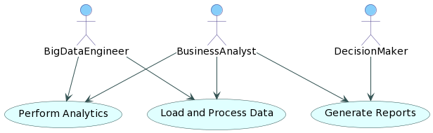
UML Diagrams
UML stands for Unified Modeling Language.
USE CASE DIAGRAM
A use case diagram in the Unified Modeling Language (UML) is a type of behavioral diagram defined by and created from a Use-case analysis. Its purpose is to present a graphical overview of the functionality provided by a system in terms of actors, their goals (represented as use cases), and any dependencies between those use cases. The main purpose of a use case diagram is to show what system functions are performed for which actor. Roles of the actors in the system can be depicted.

Slide 19
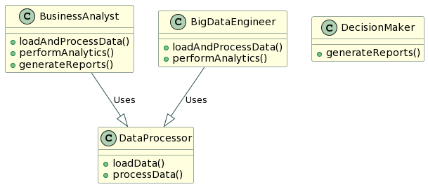
CLASS DIAGRAM:
In software engineering, a class diagram in the Unified Modeling Language (UML) is
a type of static structure diagram that describes the structure of a system by showing the system's classes, their attributes, operations (or methods), and the relationships among the classes. It explains which class contains information.

Slide 20
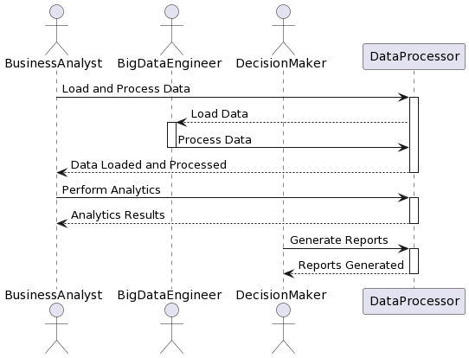
SEQUENCE DIAGRAM:
A sequence diagram in Unified Modeling Language (UML) is a kind of interaction diagram that shows how processes operate with one another and in what order. It is a construct of a Message Sequence Chart. Sequence diagrams are sometimes called event diagrams, event scenarios, and timing diagrams.

Slide 21
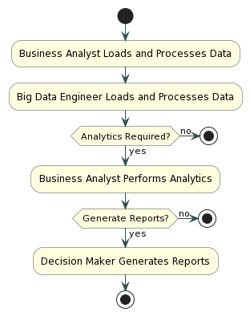
COLLABRATION DIAGRAM:
Activity diagrams are graphical representations of workflows of stepwise activities and actions with support for choice, iteration and concurrency. In the Unified Modeling Language, activity diagrams can be used to describe the business and operational step-by-step workflows of components in a system. An activity diagram shows the overall flow of control.

Slide 22
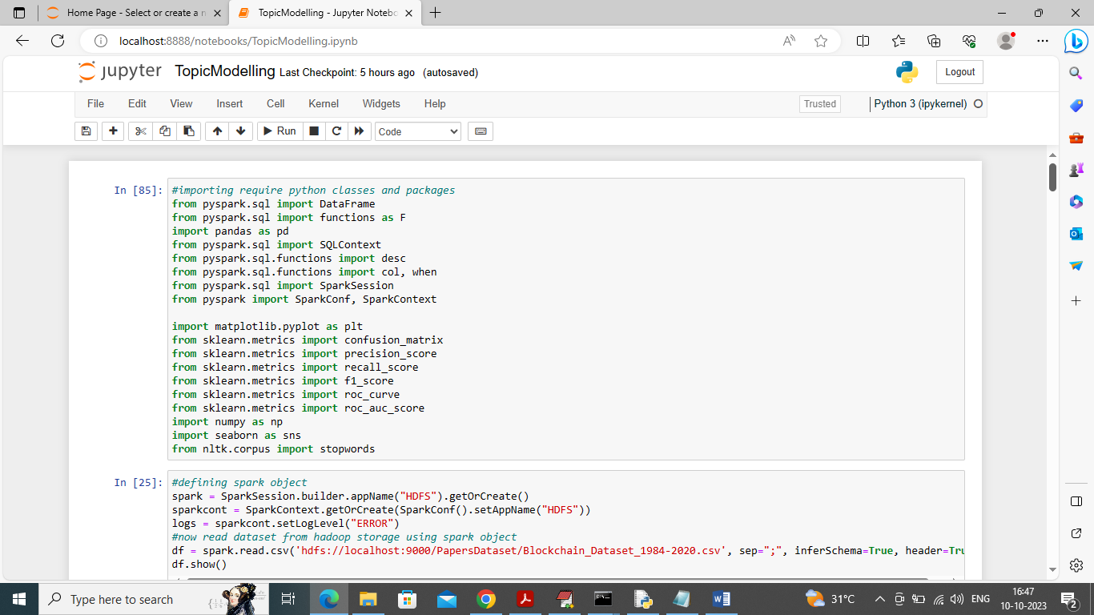
We have coded this project using JUPYTER notebook so you will get below screen with code, output and blue colour comments
In above screen we are importing required SPARK packages and then in next block we are initializing spark session which will read dataset from HADOOP and then display below output

Slide 23
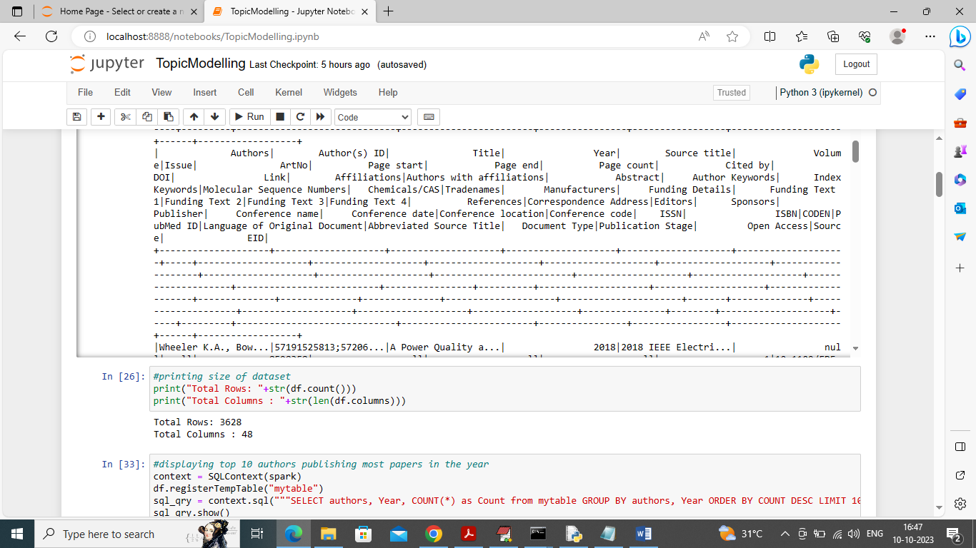
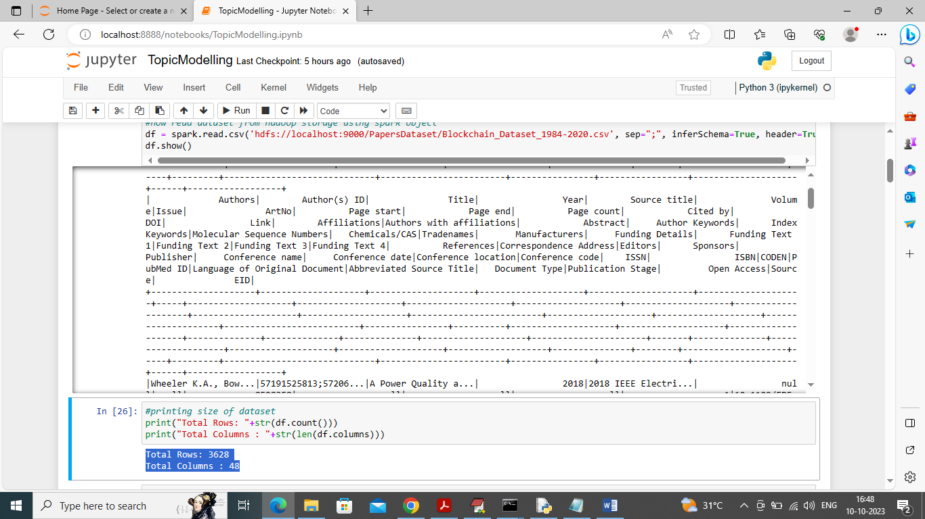
In above screen we can see dataset values loaded from HADOOP to spark and now spark will analyse this dataset for visualization and other analysis
In above screen in blue colour text displaying total rows and column found in dataset

Slide 24
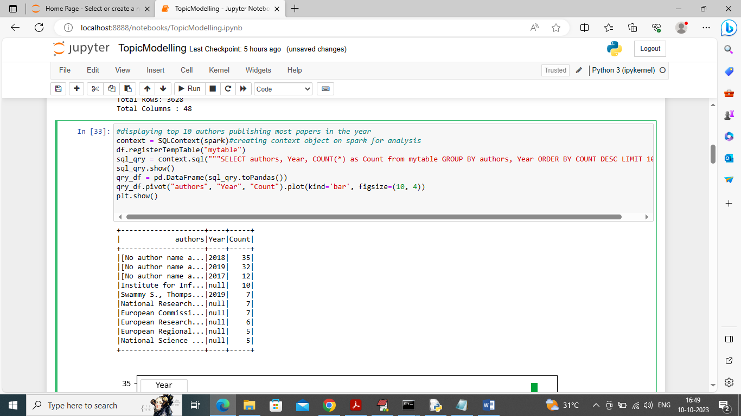
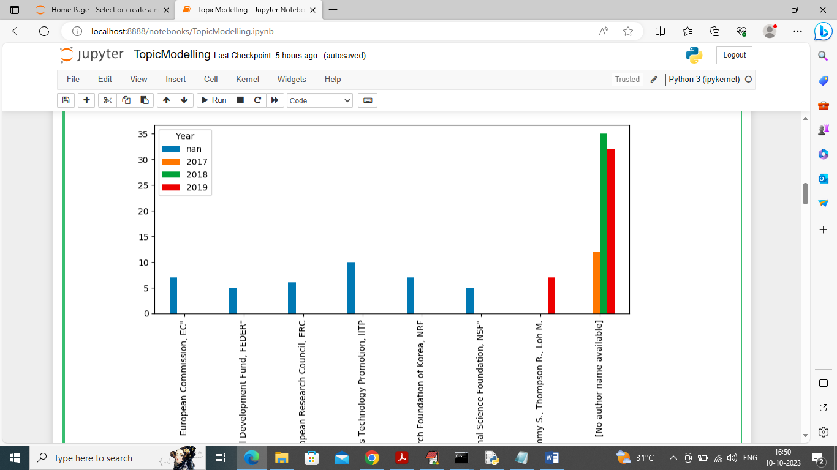
In above screen using spark we are executing query to find top 10 authors who publish more papers in particular year and in tabular format we got out as Author name, year and number of publish and in below screen we can see the graph.
In above graph x-axis represents author names and y-axis represents number of publishing done by those authors.

Slide 25
System Testing
Unit Testing
Unit testing is usually conducted as part of a combined code and unit test phase of the software lifecycle, although it is not uncommon for coding and unit testing to be conducted as two distinct phases.
Test strategy and approach
Field testing will be performed manually and functional tests will be written in detail.
Test objectives
All field entries must work properly.
Pages must be activated from the identified link.
The entry screen, messages and responses must not be delayed.

Slide 26
Integration Testing
Software integration testing is the incremental integration testing of two or more integrated software components on a single platform to produce failures caused by interface defects.
The task of the integration test is to check that components or software applications, e.g. components in a software system or – one step up – software applications at the company level – interact without error.
Test Results: All the test cases mentioned above passed successfully. No defects encountered.
Acceptance Testing
User Acceptance Testing is a critical phase of any project and requires significant participation by the end user. It also ensures that the system meets the functional requirements.
Test Results: All the test cases mentioned above passed successfully. No defects encountered.

Slide 27
Conclusion
In conclusion, the "Spark-Based Big Data Analytics Framework for Competitive Intelligence" project represents a significant step towards empowering organizations with the tools needed to navigate and thrive in competitive markets. The integration of Apache Spark ensures efficiency, scalability, and real-time insights, providing a competitive edge in strategic decision-making.

Slide 28


